Slide 1

SLCFD Fire Board
FY 2026-27
Preliminary Millage and Budget
St. Lucie County Fire District
August 19, 2026
Notes:
Good evening Chair and all other fire board members. For the record I am the Assistant Fire Chief and Interim Clerk Treasurer Brain Gonzalez
I will be presenting to you this evening a quick preview of the 2024-2025 Budget.

Slide 2
TAXABLE VALUE AND REVENUE “TRENDS”
Notes:
We ask the Board to set the millage rate at 3.0000 mills
The first public budget hearing has been set for Wednesday, September 4th
We ask the Board to set the final hearing date for Wednesday, September 18th

Slide 3
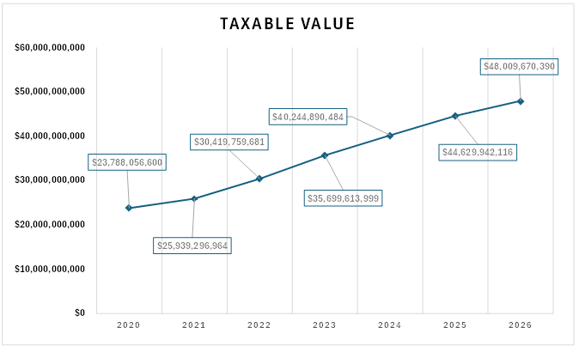
Taxable Value Trend
2026 Taxable value @ $48,009,670,390
2025 Taxable value @ $44,629,942,116
Increase @ $3,379,728,274, or 7.6%
Property value increases
are trending lower:
10.9% in 2025
12.7% in 2024
17.4% in 2023
17.3% in 2022
Notes:
The proposed increase to the general budget is approx. 20.44%.
The chart also shows the increase in our reserve accounts, which reflects the total budget of 209 million

Slide 4
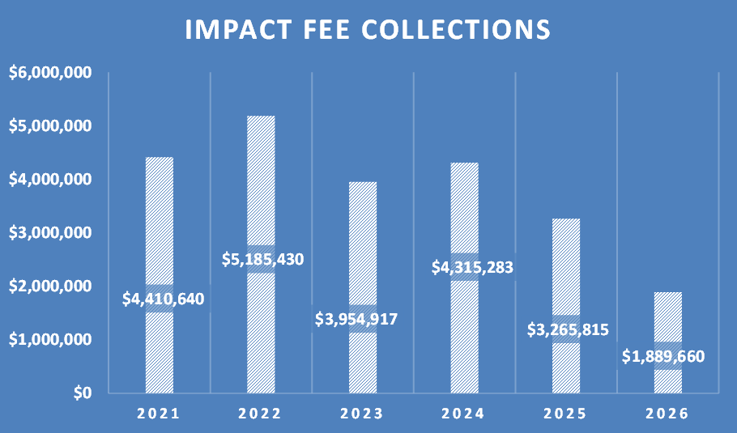
Impact fee collections are trending lower (2025-26 as of 08/14/2026)
Notes:
New Firefighters are for manning of new fire stations
Captains, Lt's, and Engineers are also to man new fire stations
Captains for CORe Program is for the near positions created from the Grant acquired from South Florida Behavioral to assist with Medicated Assisted Treatment for narcotic OD's within the county
This year a need was identified too create a position at the EOC for Emergency Management and oversee the communications division. This position is not a new position however being reclassified from Captain to BC
All other positions (Captain in CRR, LT for HSO, IT support, Accounts payable, HR) are to assist with the increase in workload due to growth

Slide 5
2026-27 PROPOSED BUDGET
Notes:
We ask the Board to set the millage rate at 3.0000 mills
The first public budget hearing has been set for Wednesday, September 4th
We ask the Board to set the final hearing date for Wednesday, September 18th

Slide 6
FY 2026-2027 Preliminary Budget Summary
General Fund $233,692,722
Other Funds $2,899,529
Total Budget $236,592,251

Slide 7
FY 2026-2027 Preliminary Budget Compared to 2025-26 Preliminary Budget
2026-27 Preliminary Total @ $236,592,251
2025-26 Preliminary Total @ $227,663,934
Increase @ $8,928,317

Slide 8
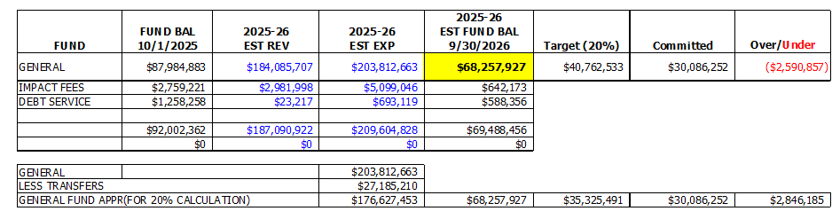
Reserve Balances
Assumes budgeted revenues and appropriations = actuals 09/30/26
⁽¹⁾
Notes:
This slide reflects our current cash reserve status (restricted and unrestricted funds).
As you can see our current Emergency Reserves is just over $19 million and has been slowly increasing over the years.

Slide 9
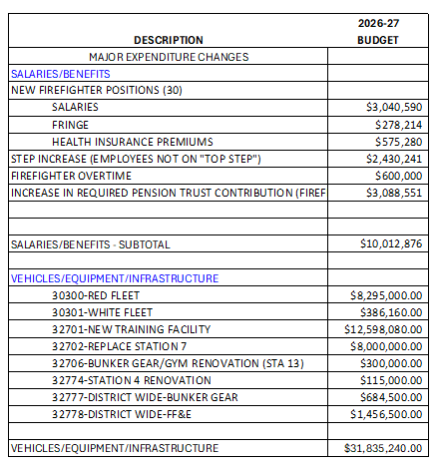
Major Initiatives Included in the
2026-2027 Budget
Notes:
Over $10 million dollars of the total budget is for Apparatus.
During last months Fire Board meeting Chief Cristaldi presented a detailed breakdown of the need to replace and refurbish our current fleet of apparatus.
All of these projects together have over a 33 million dollar impact to the budget

Slide 10
FY 2027 Total Preliminary Budget @ $236,592,251
Expenditures – All Funds Combined
Notes:
This break down of the proposed budget is based on a millage of 3.000

Slide 11
CAPITAL IMPROVEMENT PLAN
2026-27 THRU 2030-31 ($95.2M)
Notes:
We ask the Board to set the millage rate at 3.0000 mills
The first public budget hearing has been set for Wednesday, September 4th
We ask the Board to set the final hearing date for Wednesday, September 18th

Slide 12
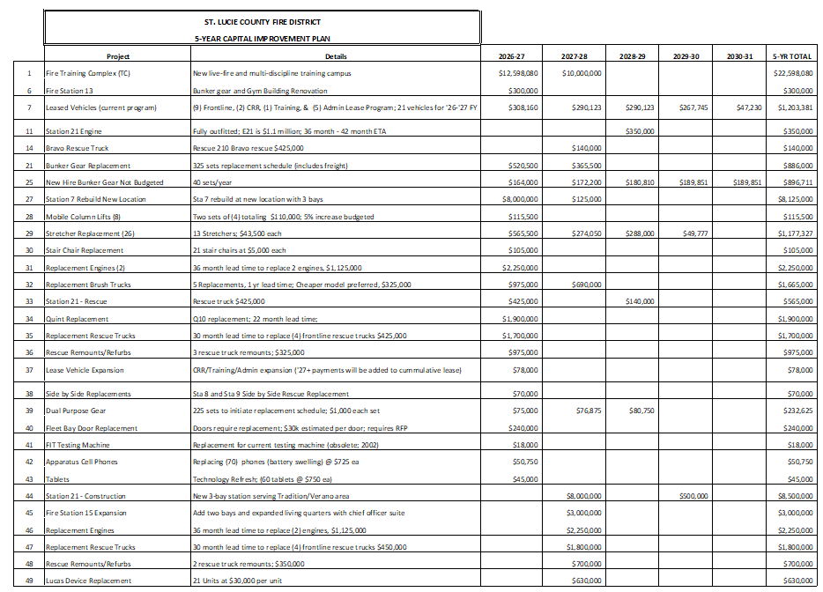
Notes:
Over $23 million dollars of the total budget is for new construction, expansions, rebuild and renovations of fire stations.
Chief Langel presented a detailed breakdown of each project last month.
Due to the growth with in the county these projects are a necessity.
New construction station 18, 10, and 20
Expansion of station 10, 12, logistics building and fleet
Rebuild of station 7
Renovation of milner

Slide 13
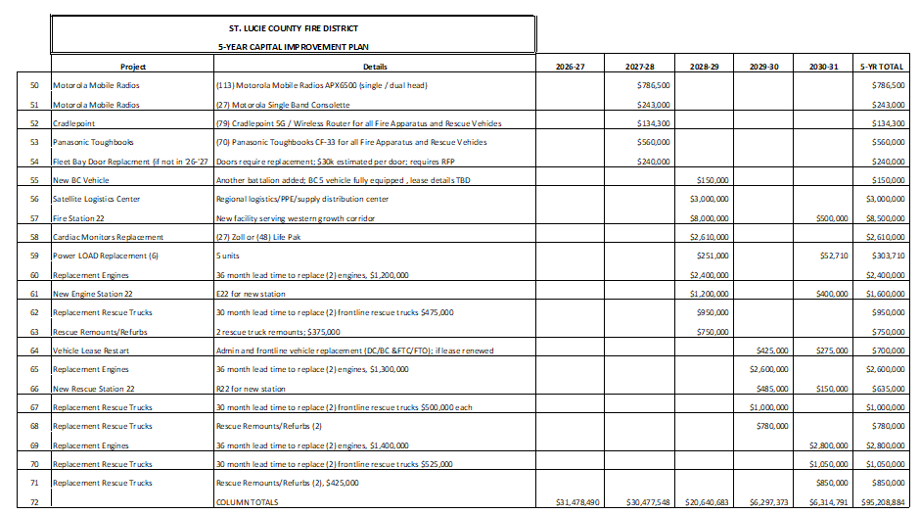
Notes:
Over $23 million dollars of the total budget is for new construction, expansions, rebuild and renovations of fire stations.
Chief Langel presented a detailed breakdown of each project last month.
Due to the growth with in the county these projects are a necessity.
New construction station 18, 10, and 20
Expansion of station 10, 12, logistics building and fleet
Rebuild of station 7
Renovation of milner

Slide 14
MILLAGE (TAX) RATES AND PUBLIC HEARINGS
Notes:
We ask the Board to set the millage rate at 3.0000 mills
The first public budget hearing has been set for Wednesday, September 4th
We ask the Board to set the final hearing date for Wednesday, September 18th

Slide 15
Recommended Millage Rate
The Recommended millage rate is at 3.0000 mills
  The Tentative Budget Hearing is scheduled to be held
  Wednesday, September 9, 2026, at 5:01 p.m.,
  in the SLCFD Administration Fire Board Chambers.
  The Final Public Budget Hearing is scheduled to be held
  Wednesday, September 16, 2026, at 5:01 p.m.,
  in the SLCFD Administration Fire Board Chambers.
Notes:
We ask the Board to set the millage rate at 3.0000 mills
The first public budget hearing has been set for Wednesday, September 4th
We ask the Board to set the final hearing date for Wednesday, September 18th

Slide 16
MISCELLANEOUS
Notes:
We ask the Board to set the millage rate at 3.0000 mills
The first public budget hearing has been set for Wednesday, September 4th
We ask the Board to set the final hearing date for Wednesday, September 18th

Slide 17


New Accounting Software
Legacy Enterprise Resource Platform (ERP)
New (ERP)System
Department 430 = “Construction Projects”
Notes:
Over $10 million dollars of the total budget is for Apparatus.
During last months Fire Board meeting Chief Cristaldi presented a detailed breakdown of the need to replace and refurbish our current fleet of apparatus.
All of these projects together have over a 33 million dollar impact to the budget

Slide 18
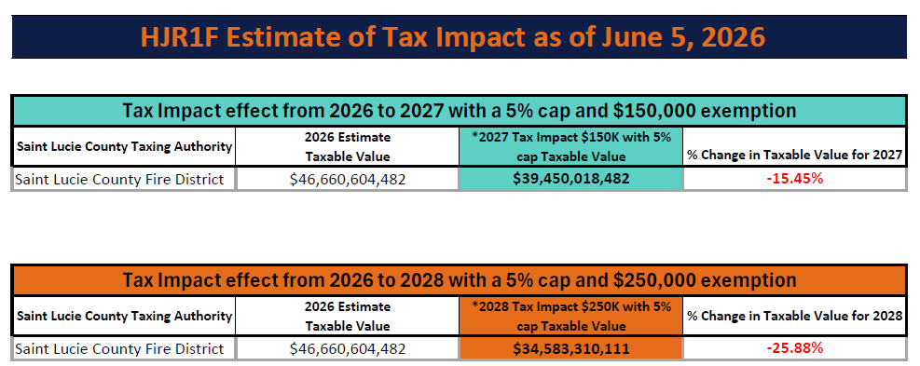
Florida Amendment 3
Homestead Tax Exemptions
The “2026 Estimate” of $46.66B is from the original 06/05/2026 SLCPA estimate.
Notes:
Over $10 million dollars of the total budget is for Apparatus.
During last months Fire Board meeting Chief Cristaldi presented a detailed breakdown of the need to replace and refurbish our current fleet of apparatus.
All of these projects together have over a 33 million dollar impact to the budget

Slide 19
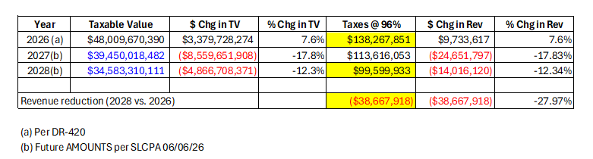
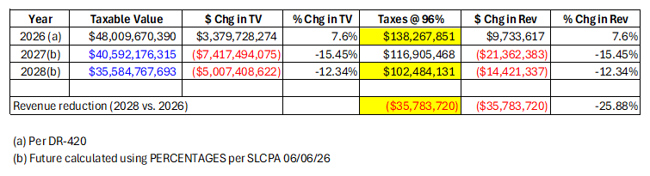
Florida Amendment 3
Homestead Tax Exemptions
*
*
(*) These two slides use the “certified taxable value” of $48.01B as of 07/01/2026.
Notes:
Over $10 million dollars of the total budget is for Apparatus.
During last months Fire Board meeting Chief Cristaldi presented a detailed breakdown of the need to replace and refurbish our current fleet of apparatus.
All of these projects together have over a 33 million dollar impact to the budget

Slide 20
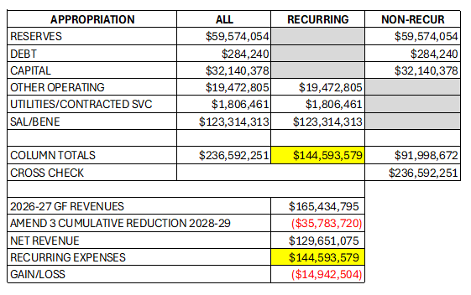
Florida Amendment 3
Homestead Tax Exemptions
Recurring total @ $144.6M of which $123.3M is salary/benefits = 85.3%
Notes:
Over $10 million dollars of the total budget is for Apparatus.
During last months Fire Board meeting Chief Cristaldi presented a detailed breakdown of the need to replace and refurbish our current fleet of apparatus.
All of these projects together have over a 33 million dollar impact to the budget

Slide 21
Questions?
Notes:
We ask the Board to set the millage rate at 3.0000 mills
As we are working on 3 new stations, and due to the amount of housing construction, on the horizon, an additional of 7 more new stations
The First Public Budget Hearing is set for Wednesday, September 6th at 5:01pm
And the Final Public Budget Hearing is Preliminaryly set for Wednesday, September 20th at 5:01pm

